Slide 1
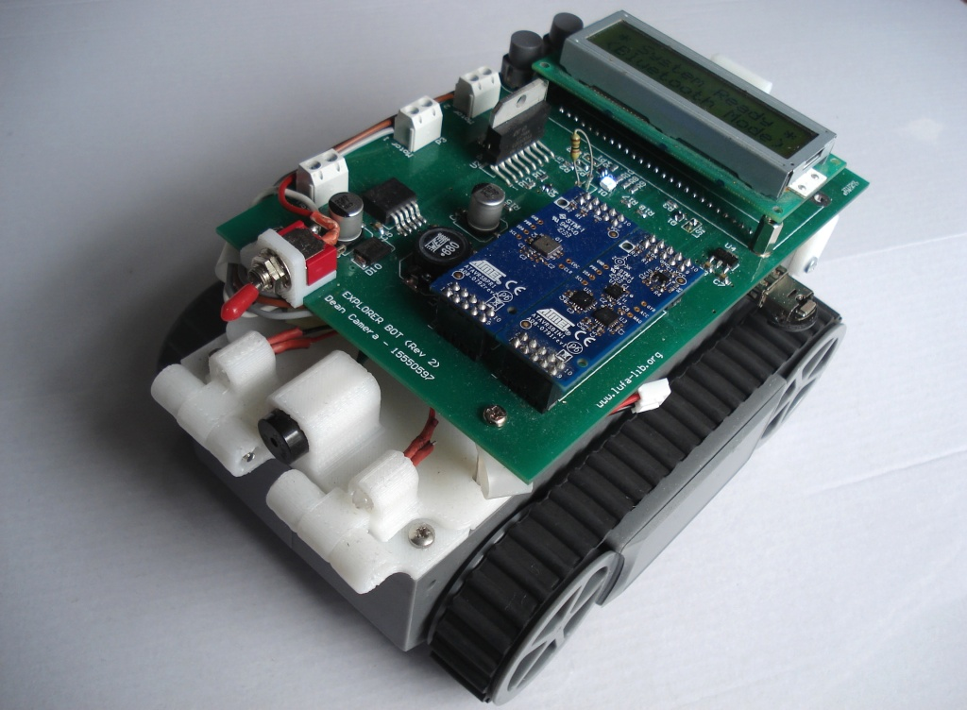
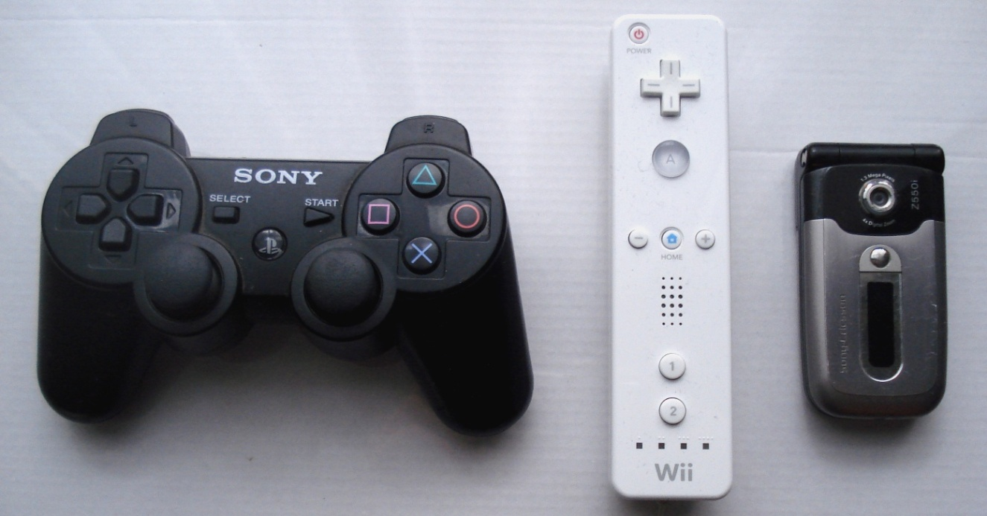
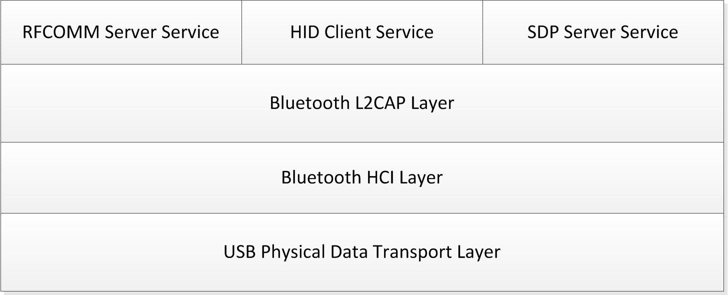
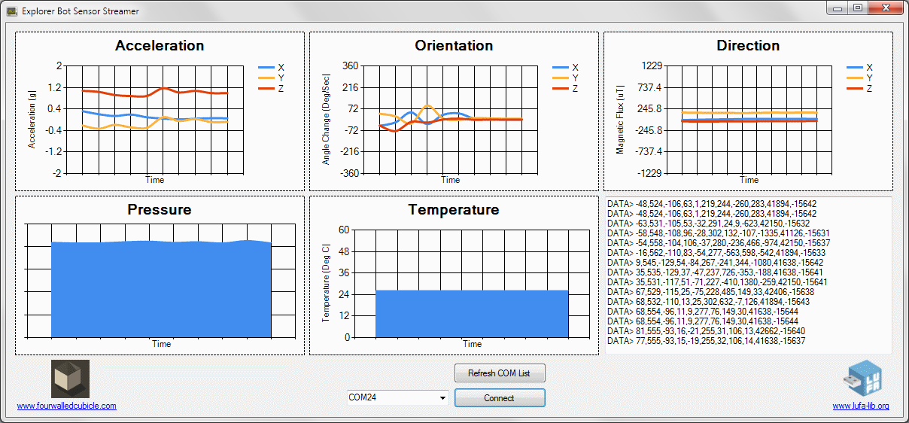
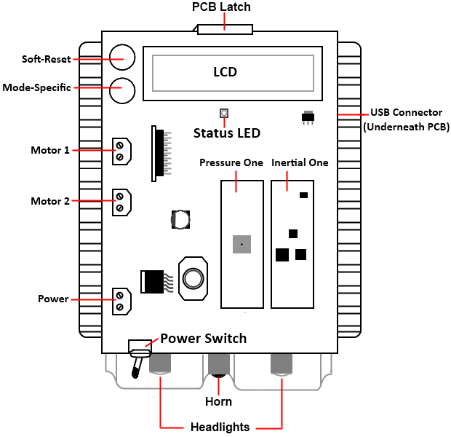
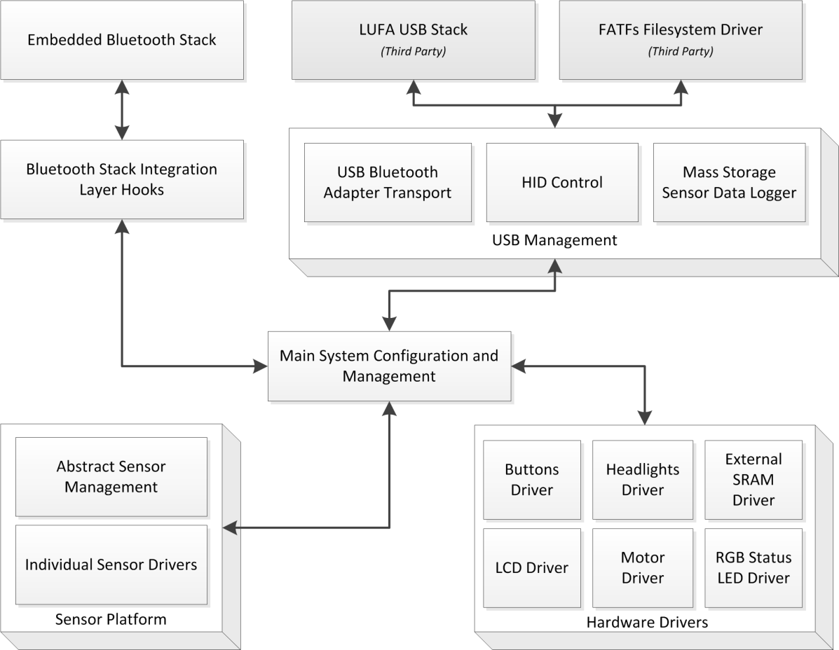
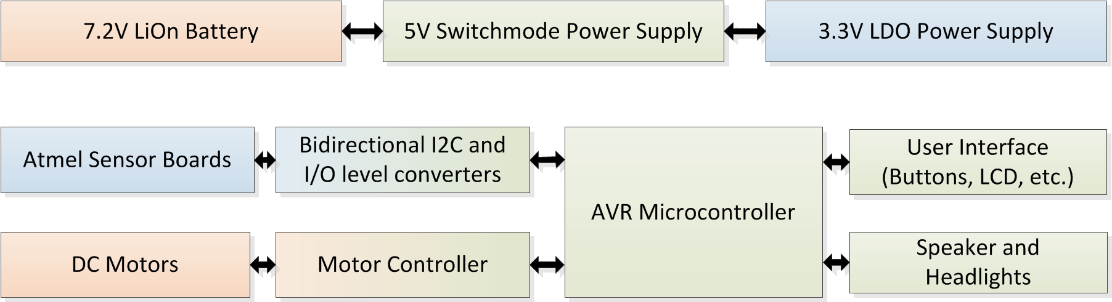
Embedded Bluetooth Stack
Introduction
Results
While Bluetooth wireless technology is present in many modern devices, its advanced protocol design has made it largely unsuitable to resource constrained embedded systems not running a full Operating System. Existing stacks on the market are expensive, proprietary and closed-source.
The purpose of this project was to design and develop a free open source embedded Bluetooth stack aimed to suit microcontrollers with very little amounts of memory and low processor clock speeds.
The completed robot and Bluetooth stack was tested against three consumer devices: a Sony Playstation 3 controller, a Nintendo Wii controller, and a Sony-Ericsson z550i mobile phone.
The robot could be wirelessly controlled while the onboard sensor data was streamed to a custom C# application and graphed in real time over a second simultaneous Bluetooth connection.
Graphed Data:
  Air Pressure
  Temperature
  Orientation
  Acceleration
  Direction
Software Design
The Bluetooth stack was developed as a series of software layers according to the Bluetooth 2.1 specifications. A set of common APIs were designed to extend the stack’s capabilities with various Bluetooth profiles.
This stack was then inserted into the robot’s firmware, to give the robot wireless Bluetooth capabilities.
Additional hardware
drivers were written
to control the other
aspects of the robot
Platform such as the
headlights, motors,
horn and LCD.
Hardware Design
To demonstrate the stack, a small battery powered wheeled robot was constructed. This robot was designed to be remotely controlled by Bluetooth enabled consumer devices such as mobile phones and game console controllers.
Equipped with sensors, the robot
is capable of streaming the sensor
data wirelessly to a remote laptop
computer over a Bluetooth link.
Conclusion
At the conclusion of this project a viable free, open source embedded Bluetooth stack and a working demonstration platform was produced, suitable for use in a wide variety of embedded devices for a low cost short-range wireless solution.
dean@fourwalledcubicle.com
www.fourwalledcubicle.com

